Slide 1

Chapter:1
Semiconductor and Diode Theory
Piecewise Linear Model, Diode as Circuit
03107101 : BASIC ELECTRONICS
Compiled by
DURVESH ASLAM
Assistant Professor
Faculty of Engineering and Technology
Parul University

Slide 2

Load-Line Analysis
SUB:B.E Piecewise Linear Model, Diode as Circuit element, Load line

Slide 3
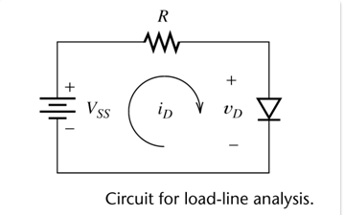
Load-Line Analysis
The word “DC” represents that the operating conditions are DC. No ac signal is present. and it is called as load line.
SUB:B.E Piecewise Linear Model, Diode as Circuit element, Load line

Slide 4
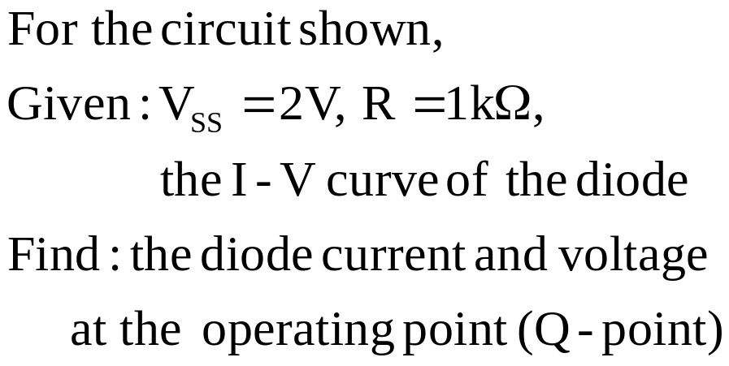
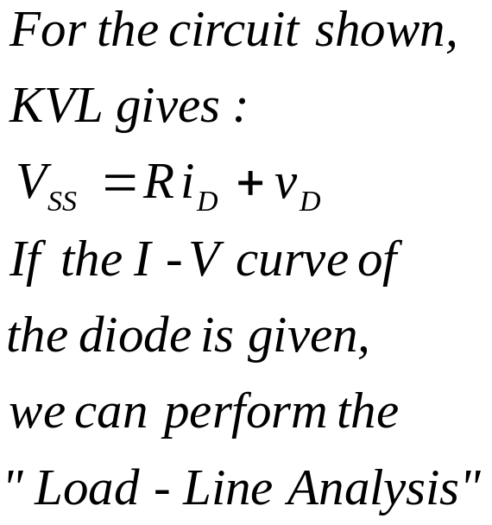
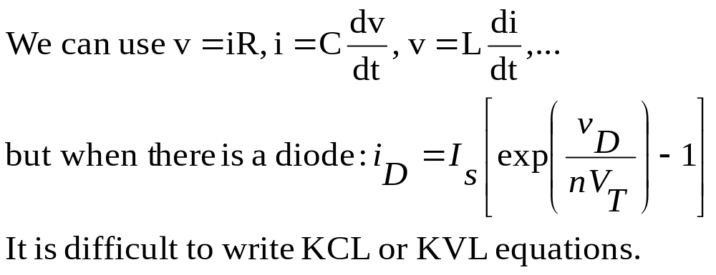
SUB:B.E Piecewise Linear Model, Diode as Circuit element, Load line

Slide 5
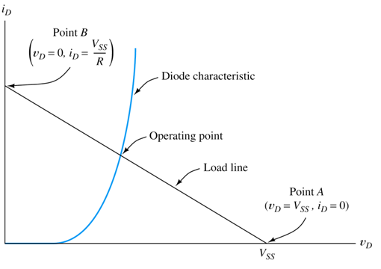
Fig: Load line analysis for the circuit.
The intersection of diode characteristics and load line is called as the Q-point.
SUB:B.E Piecewise Linear Model, Diode as Circuit element, Load line

Slide 6
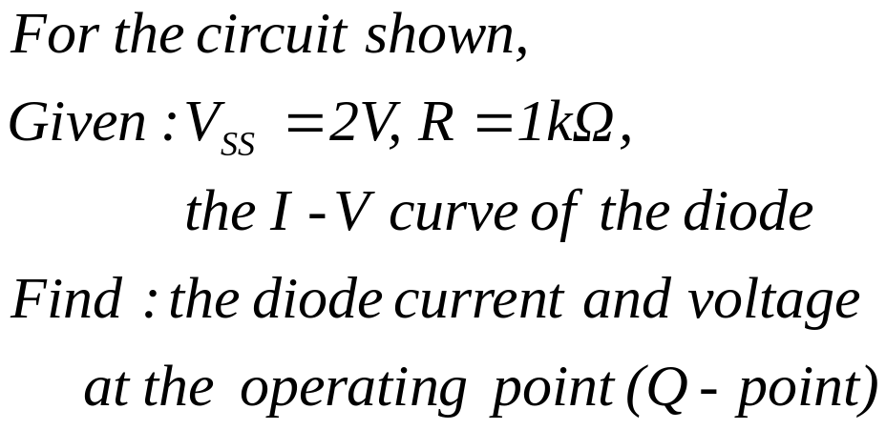
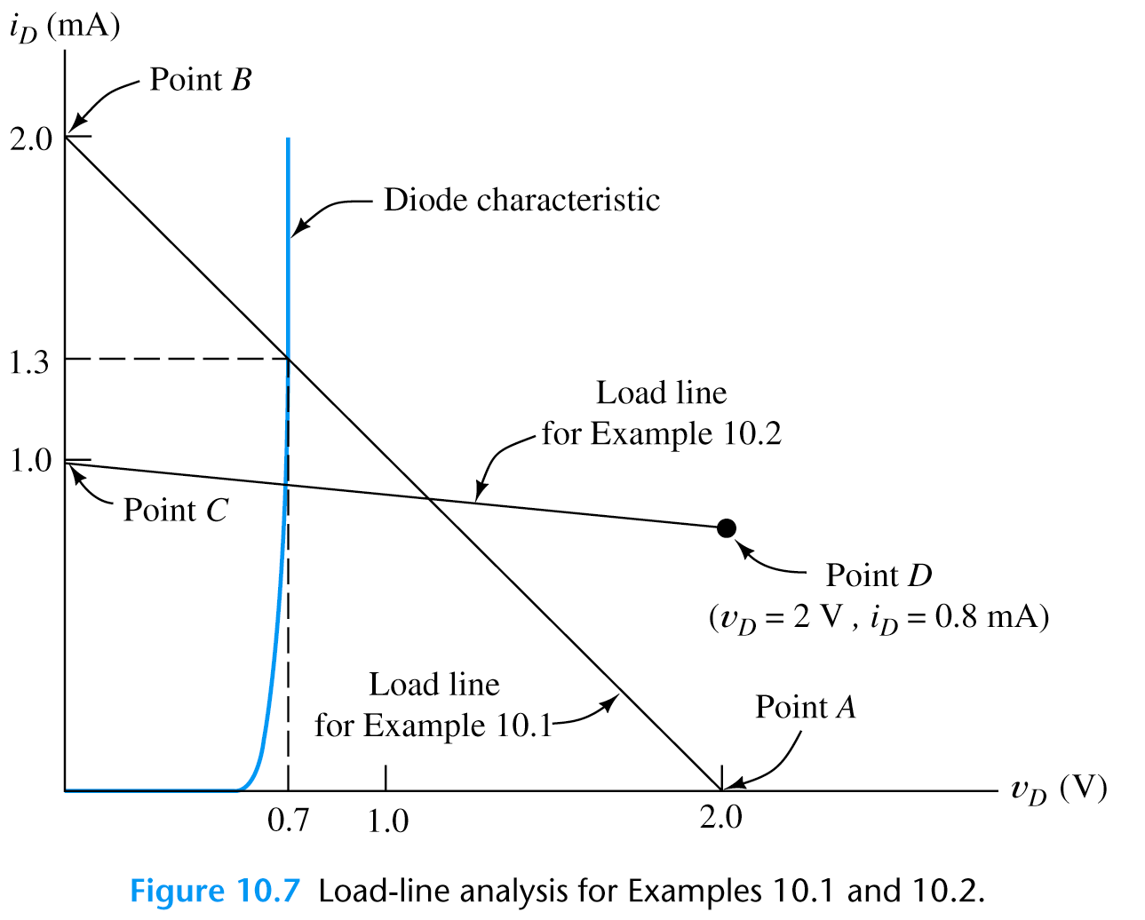
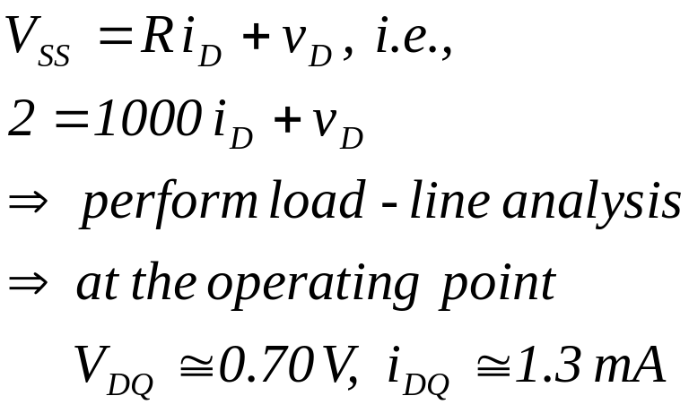
Basic Electronics.

Slide 7
Factors affecting the Load line and Q-point.
1.DC supply voltage
2.Load resistance R
3.Temperature
4.Device to device parameter variations.
SUB:B.E Piecewise Linear Model, Diode as Circuit element, Load line

Slide 8
Piece-wise Linear Model
SUB:B.E Piecewise Linear Model, Diode as Circuit element, Load line

Slide 9
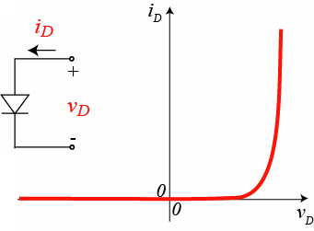
Piece-wise Linear Model
This is the third technique used for the DC analysis of a diode. it is a simpler way to approximate the V-I characteristics of a diode using linear relationships.
fig: Ideal V-I characteristics with two linear approximations
SUB:B.E Piecewise Linear Model, Diode as Circuit element, Load line

Slide 10
Approximation 1:
For Vf >= Vr, we assume that the diode characteristics is a straight line with a slope of 1/Rf.
Approximation 2:
For Vf < Vr, we assume the second straight line approximation, parallel to the Vf
Axis at zero current level.
SUB:B.E Piecewise Linear Model, Diode as Circuit element, Load line

Slide 11
The Diode as a Circuit Element
SUB:B.E Piecewise Linear Model, Diode as Circuit element, Load line

Slide 12
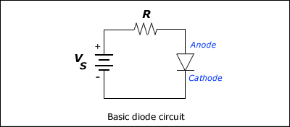
The Diode as a Circuit Element :
The basic diode circuit is shown in fig. let us analyze this circuit to obtain the instaneous current I and the instantaneous current I and the instantaneous current I and the instantaneous diode voltage V.
SUB:B.E Piecewise Linear Model, Diode as Circuit element, Load line

Slide 13
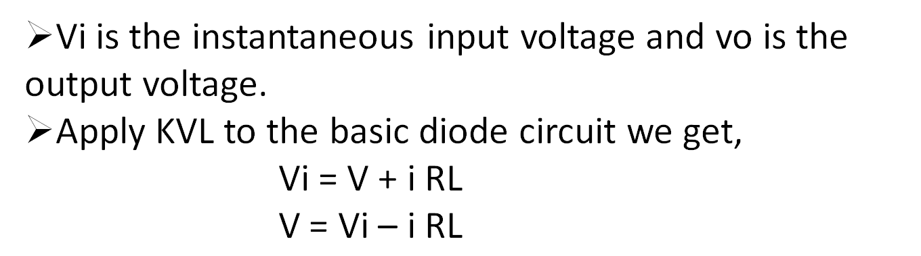
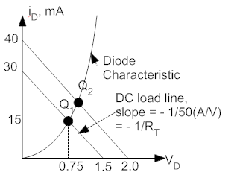
SUB:B.E Piecewise Linear Model, Diode as Circuit element, Load line

Slide 14
Diode Characteristic shows the simultaneous solutions of equation .in this characteristic equation has been plotted as a straight line and it is called as the load line.
it is called as load line because its slope is inversely proportional to the load resistance RL.
the point of intersection of the load line and static characteristics of the diode is marked as Q point.
SUB:B.E Piecewise Linear Model, Diode as Circuit element, Load line

Slide 15

SUB:B.E Piecewise Linear Model, Diode as Circuit element, Load line

